Slide 1
From Chaos to Common Good LDC
Our LDC will take us through the “5 C’s”
CHAOS
COLLABORATION
CONFLICT
COMMAND
COMMON GOOD
Each page in our ISN will be dedicated to these 5 topics, and you’ll refer to these pages when completing your final project (the story board)

Slide 2
Lets preview our final project…
How do societies come to make decisions based on the common good? After reading informational texts, students will write a story board in which you describe how civilizations evolve from trying to create order
Requirements for our storyboard
5 panels that describe each of the 5 C’s
A well written paragraph and image for each
Use of the vocab for each paragraph
Reflection questions

Slide 3
Objective
I will be able to determine the three essential needs to survive in an environment by participating in a experimental activity dealing with food, shelter and water in order to complete the Survival worksheet.

Slide 4
(Front of Room)
TV
By the fan
Steps:
A situation will be provided, and you must make your decision and go to that corner
When the timer goes off, you MUST be at one corner, and conversation comes to a zero!!!
The “reveal” will be made and students will find out who “lives” and who “dies”
The students who “die” will have to sit back at their desks, and the remaining students stay standing
Debriefing questions will be discussed, then another round will be announced
In front of the iPad cases
Next to the exit door

Slide 5
Individual 4 Corners - Water
At each corner in the room there will be a situation provided to you that simulates the human need for food, water and shelter.
You will have 30 seconds to choose a corner that you feel is best for your survival when it comes to choosing the correct water source.

Slide 6
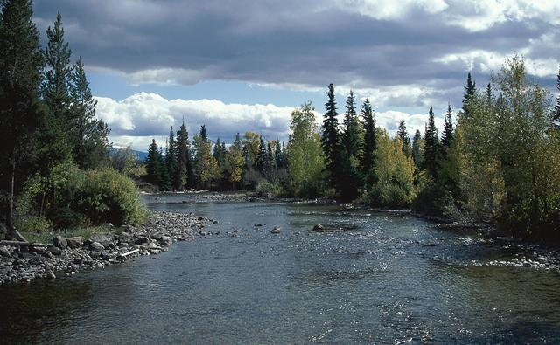
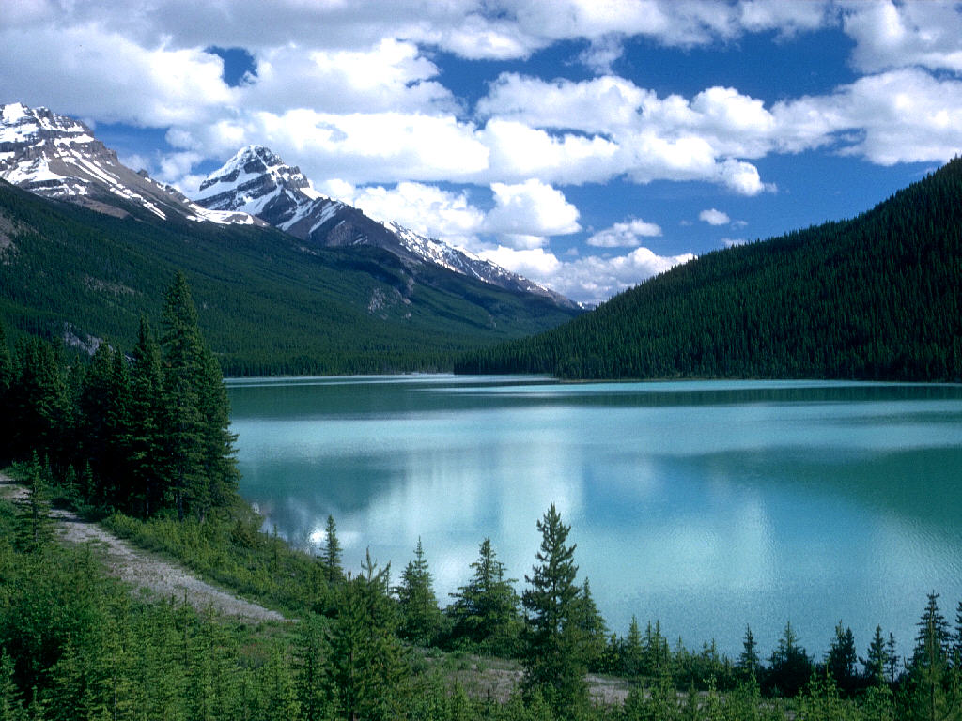
OCEAN
RIVER
LAKE
RAIN WATER

Slide 7
Write Debrief Questions on Page 17- Water
Why do you believe it is important to live by water?
What problems could you see from living next to water? Explain
What solutions can you come up with to fix these problems? Explain

Slide 8
Pair 4 Corners - Shelter
At each corner in the room there will be a situation provided to you that simulates the human need for food, water and shelter.
You and your partner will have 20 seconds to choose a corner that you feel is best for your survival when it comes to having the correct shelter.

Slide 9
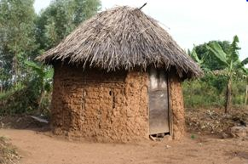
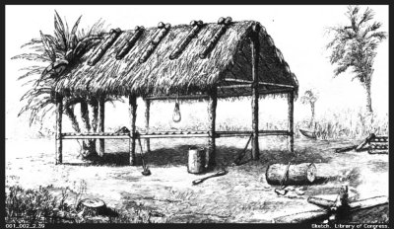
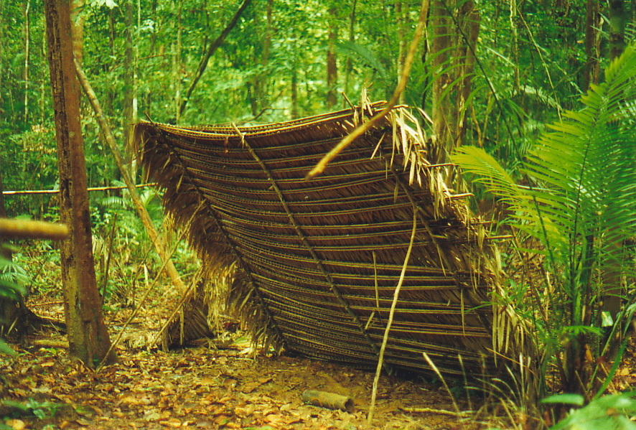
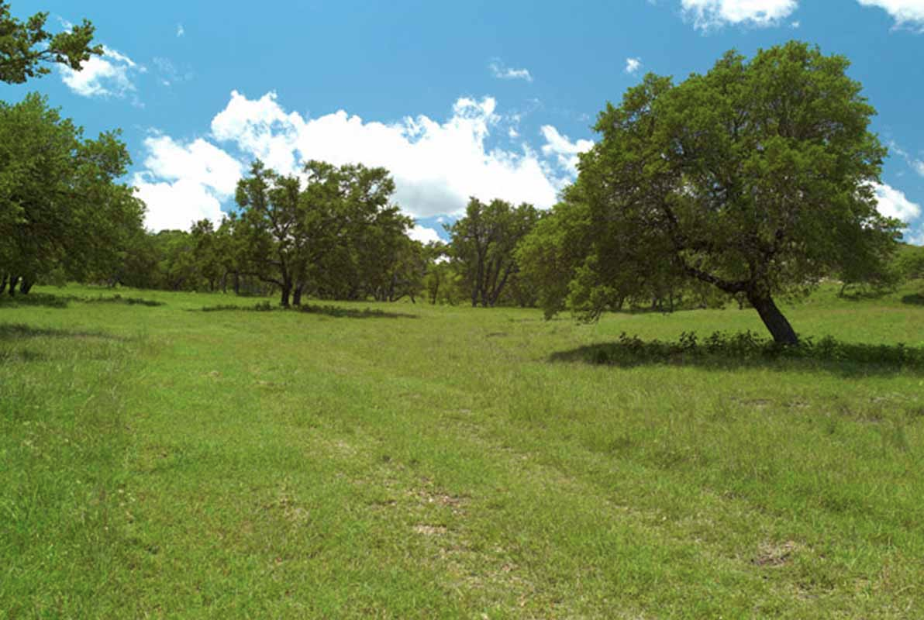
PALM LEAF CHICKEE
MUD HUT
LEAN TO
NO SHELTER NEEDED

Slide 10
Write Debrief Questions on Page 17 - Shelter
Would some shelters be easy to pack up and move in case they needed to hunt?
What dangers do you think are associated with having a permanent shelter?

Slide 11
Quad 4 Corners - Hunting
At each corner in the room there will be a situation provided to you that simulates the human need for food, water and shelter.
You and your quad will have 15 seconds to choose a corner that you feel is best for your survival when it comes to feeding your family.

Slide 12
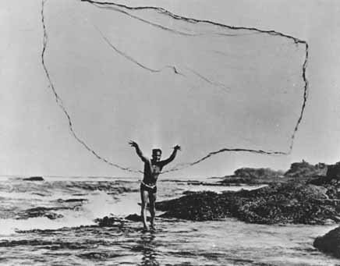
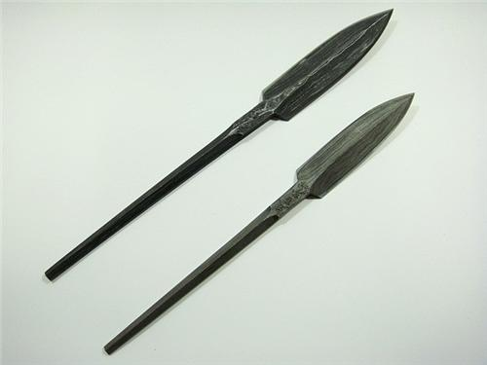
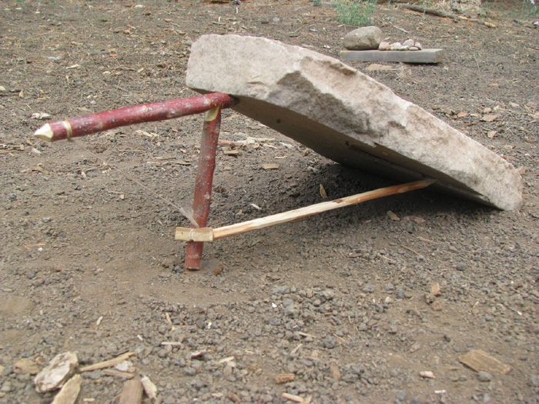
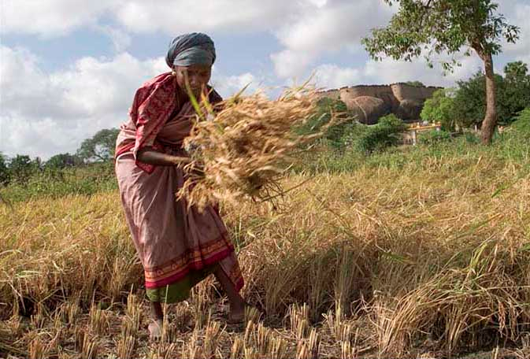
FISHING NET
SPEAR
ANIMAL TRAP
GATHERING GRAINS

Slide 13
Write Debrief Questions on Page 17 - Hunting
What dangers come with hunting?
What other types of tools could you use to hunt?
Would hunting be better done as a group or by yourself? Explain
What problems can hunting as a group create?

